Slide 1
Adaboost Classifier in Python
Machine Learning Final Project
March 26th 2020
Group 4 (Wanzhou Lei, Zhuo Wu, Xinhang Liu)

Slide 2
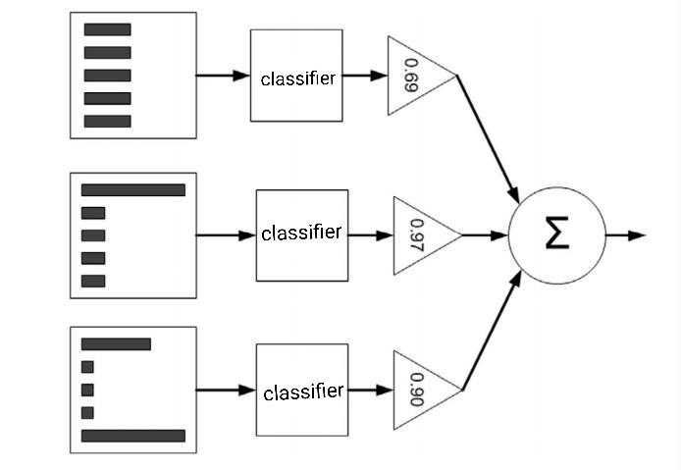
Introduction of AdaBoost Model
Alpha
Notes:
Describe the problems
Why we choose adaboost
Explain the approach

Slide 3
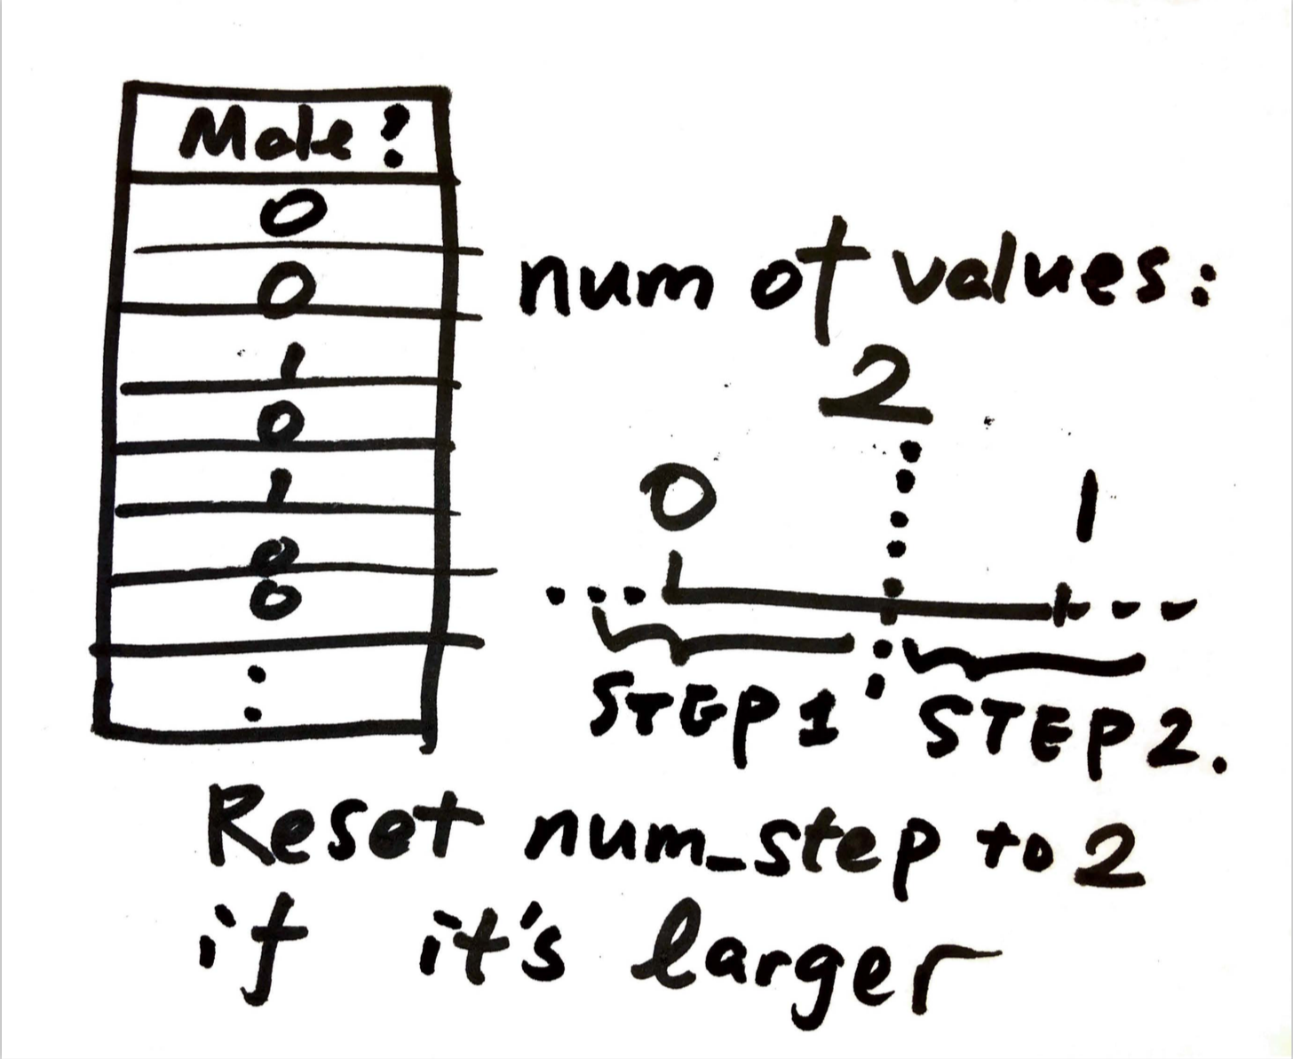
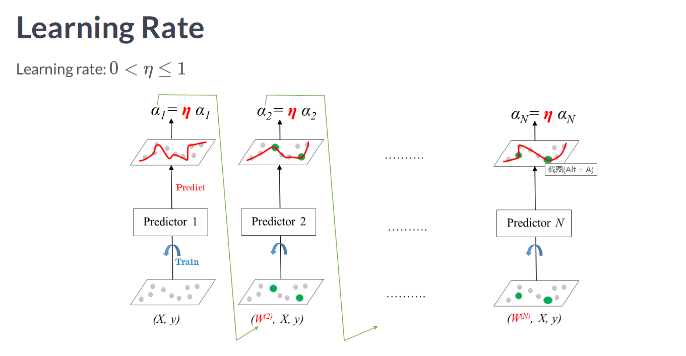
Introduction of our code : Idea of using OOP to build models
Class StumpClassfier(num_steps=20)
Attributes:
self._alpha
self. _num_steps
self._splitting_dimen
self._splitting_value
self._threshold_ineq
self. _feature_number
Member Functions:
fit(self,X,y,weights=[],check_data=True)
predict(self,X,check_data=True)
score(self,X,y)
update_alpha(self,learning_rate):
__str__(self):
Class AdaBoostClassfier(n_estimators=50,
learning_rate=1.0,num_steps=20):
Attributes:
self._n_estimators
self._learning_rate
self._num_steps
self._all_stumps
self._feature_number
Member Functions:
fit(self,X,y,check_data=True)
predict(self,X,check_data=True)
score(self,X,y):
get_stumps(self)
__str__(self)

Slide 4
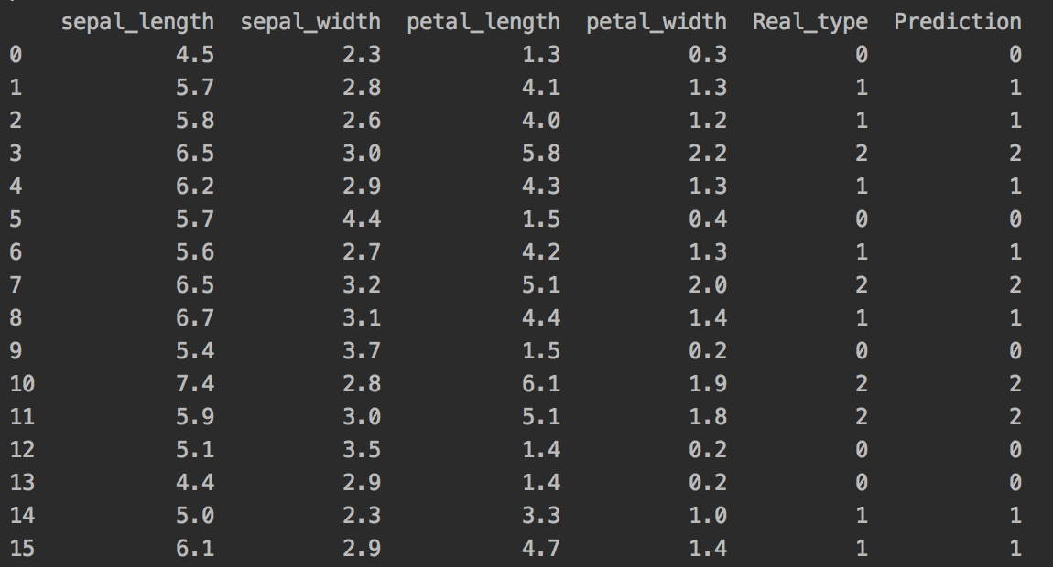
Data Processing and Analyzing: Iris Dataset
4 Features
150 Observations
(Small Dataset)
Multi Class
Modify Adaboost to Make Multi-class Classification Possible !!

Slide 5
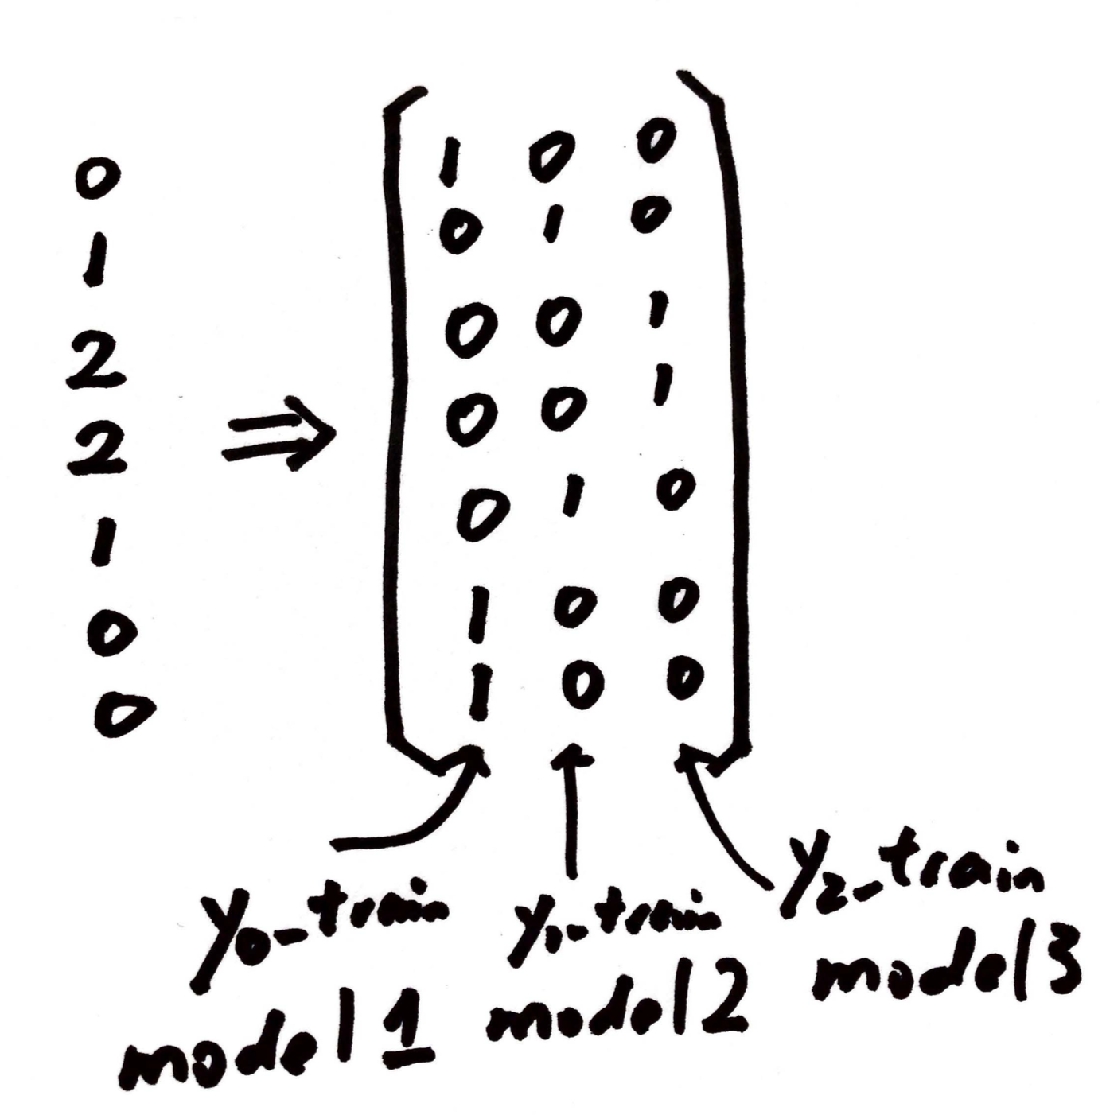
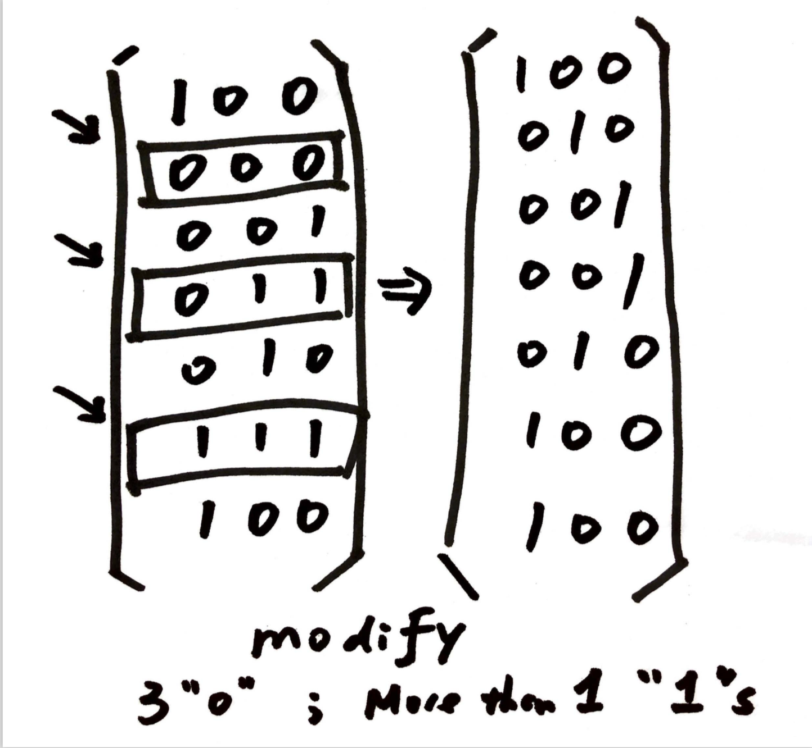
Binary→ Multi class Classification: One vs All
Training the Model
Predicting
toMatrix()
processDF()
Notes:
Some new code

Slide 6
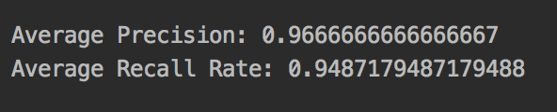
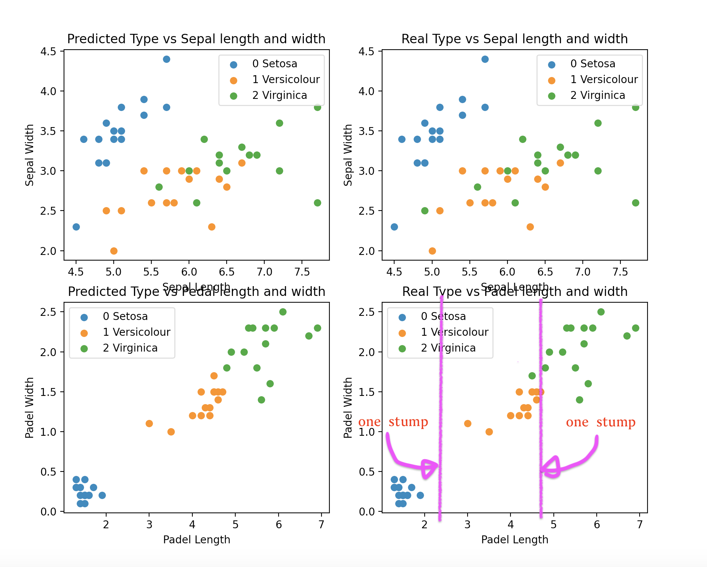
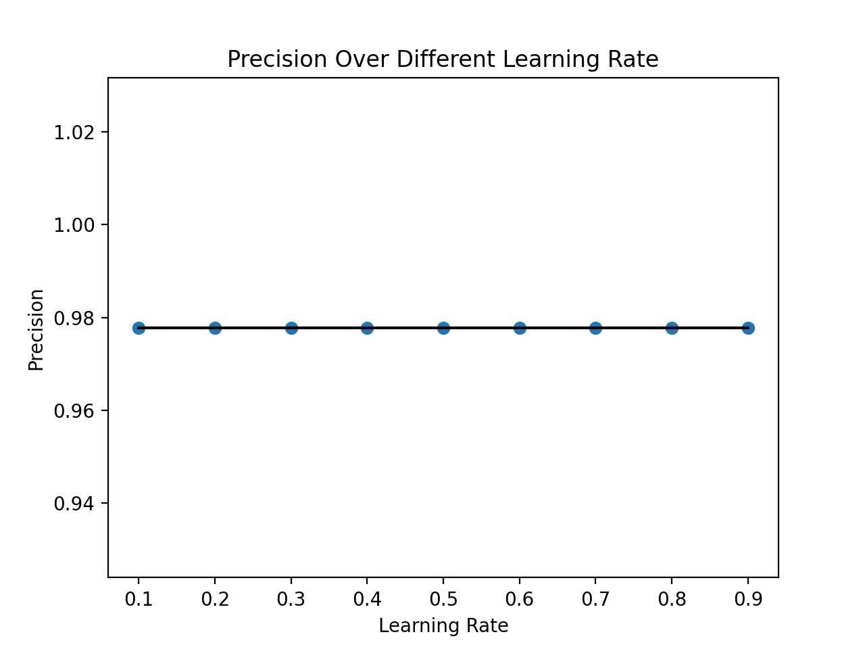
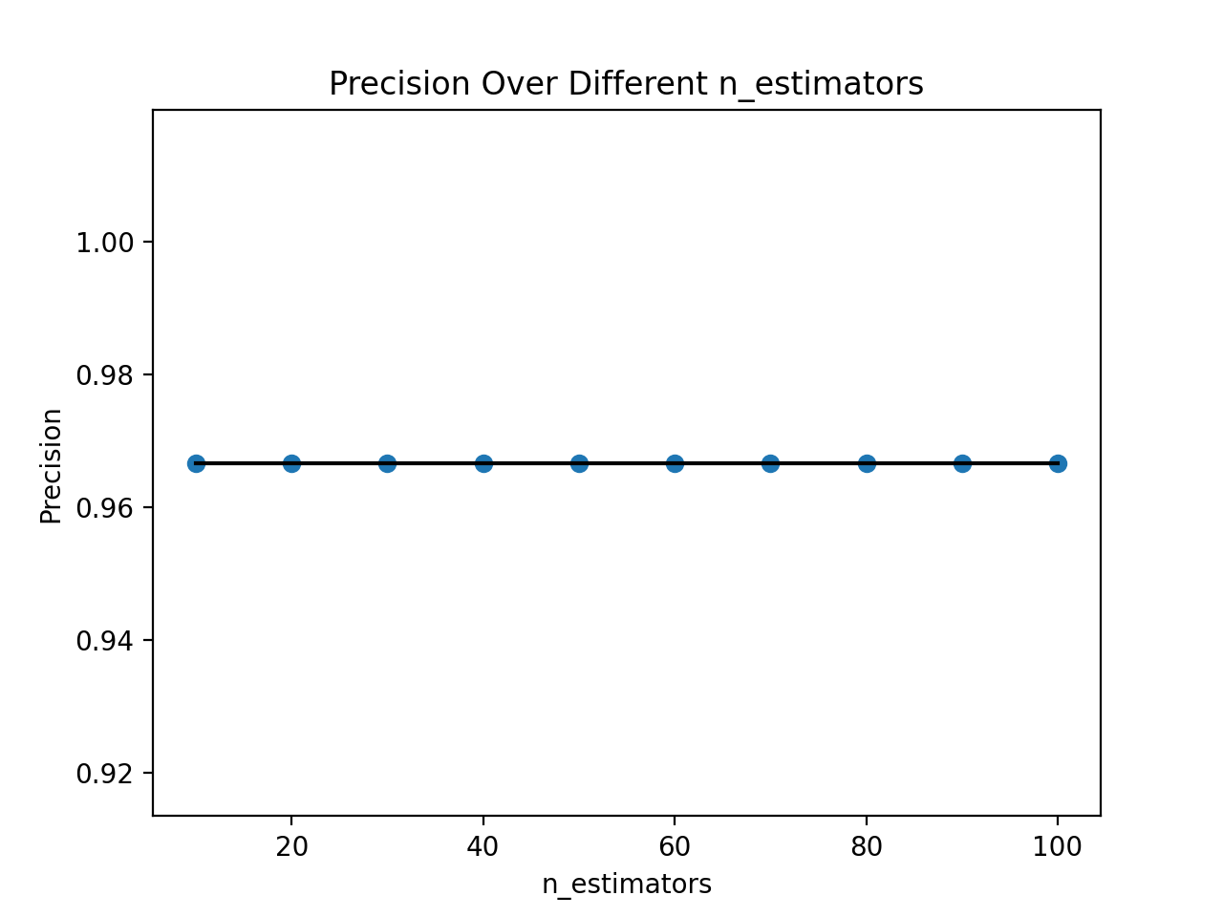
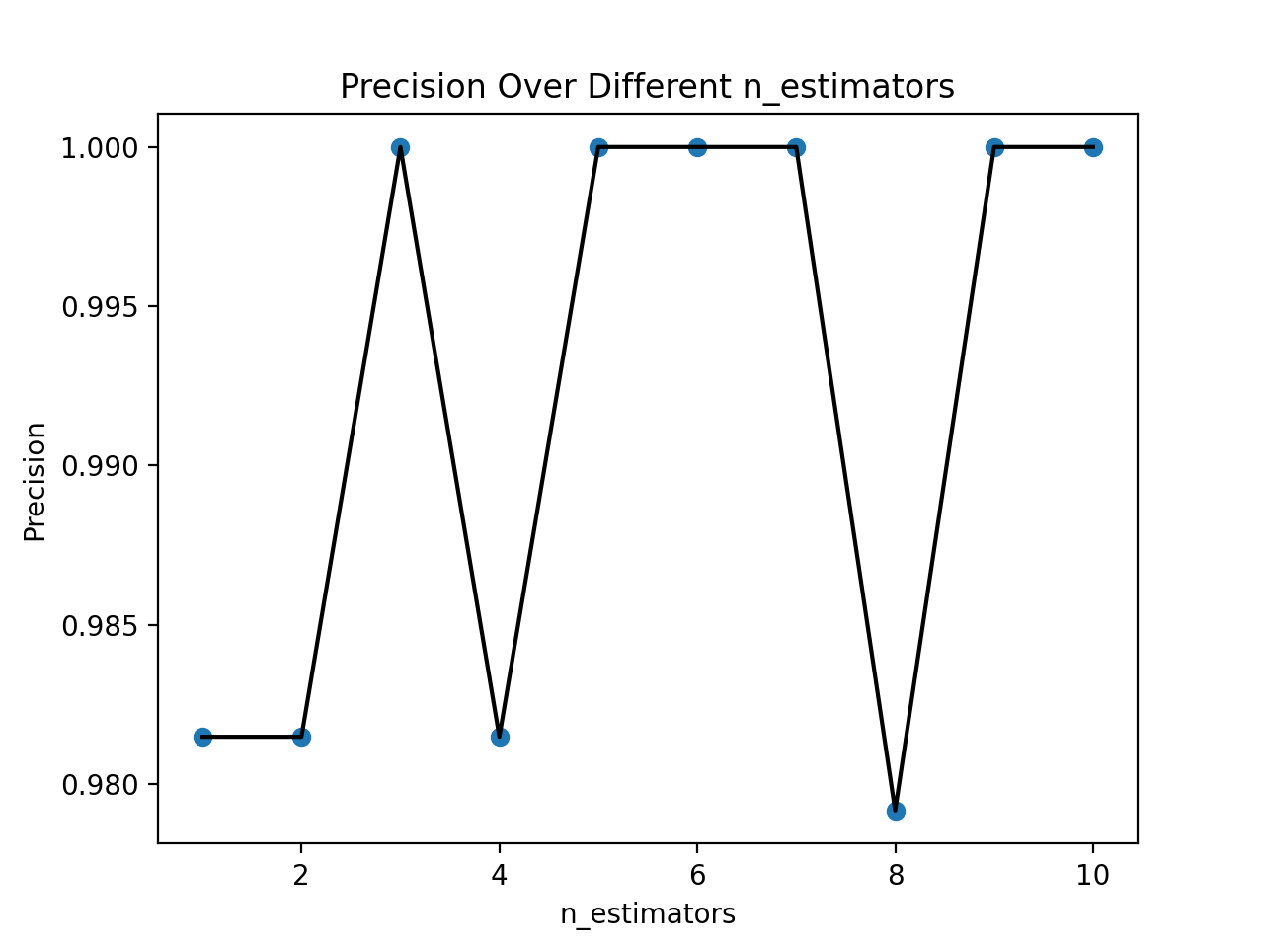
Tuning Hyper-Parameter & Result （Iris Dataset)
Hyper-Parameter Visualization
Dataset too easy, hyer-parameters are uncessary.
Notes:
Describe the code[packages, new]
1 vs. all 原理 （multi class）
Learning rate 变量

Slide 7
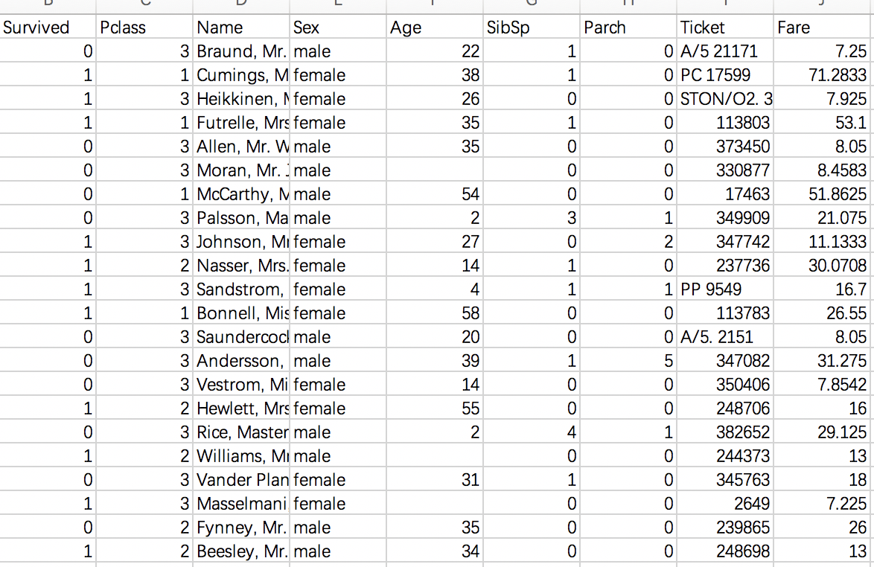
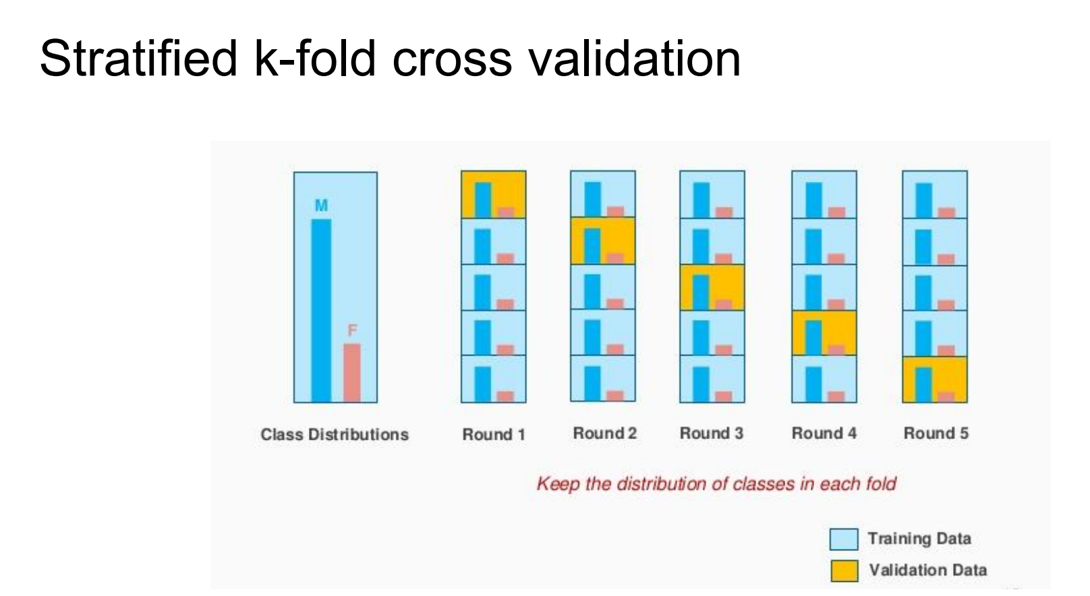
Titanic Dataset
Some of the age data are lost.
Calculate the mean age and fill these lost ages with the mean age.
2. Dataset is unbalanced
342 of 892 people(only 38%) survived.
Problem: If use ordinary k fold CV. In each fold the proportion of survived would be different (some higher like 50%, soime lower like 10%)
Fix: Stratified k fold Cross Validation.
6 fetures
892 0bservations
Idea: keep the proportion of survived people in each fold to be the same (38%)
Notes:
Present your results

Slide 8
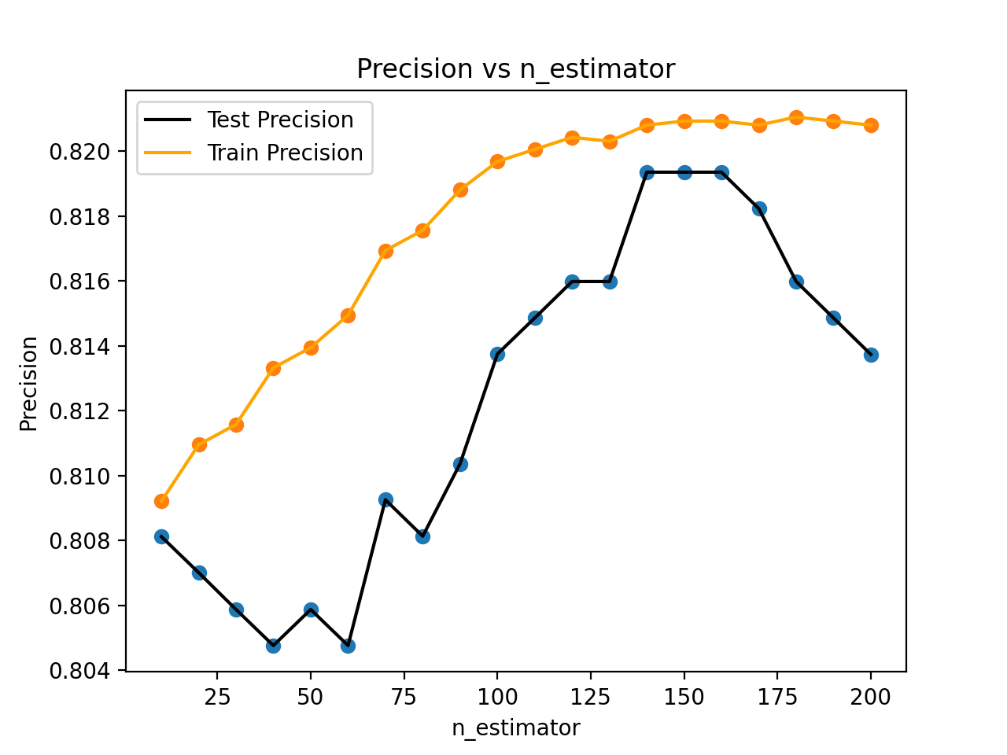
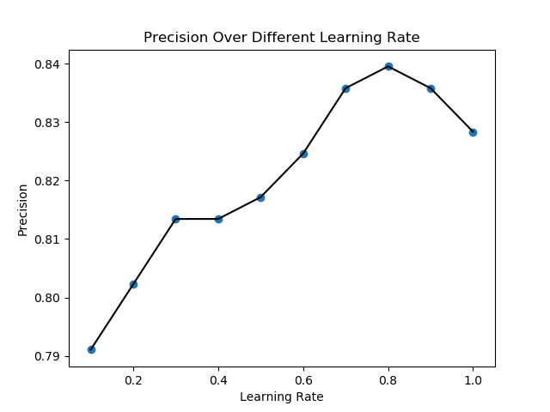
Stratified CV of Titanic Dataset
Note that: two hyper-parameters learning rate and n_estimnator are interrelated. There is offset between decreasing learning rate and increasing n_estimators
For convenience, I only tune the n_estimator hyper-parameter.
Best n_estimator: 140
Learning rate=1
Notes:
Describe their meaning

Slide 9
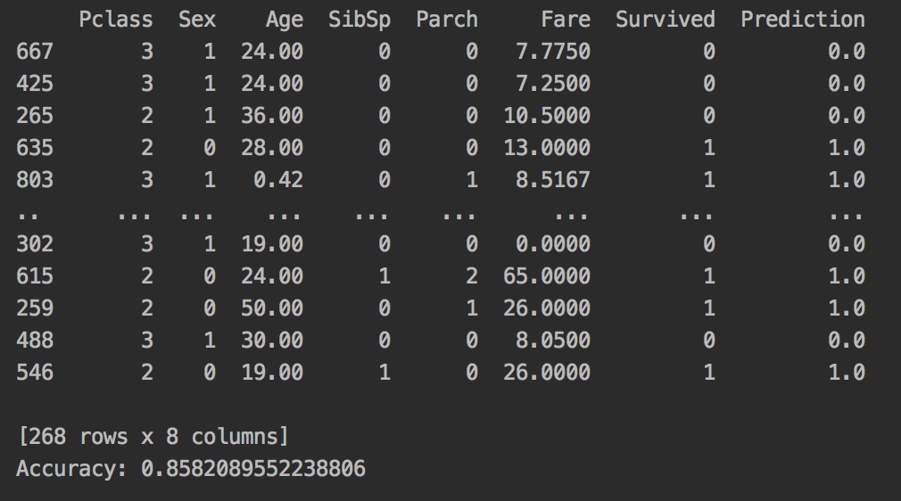
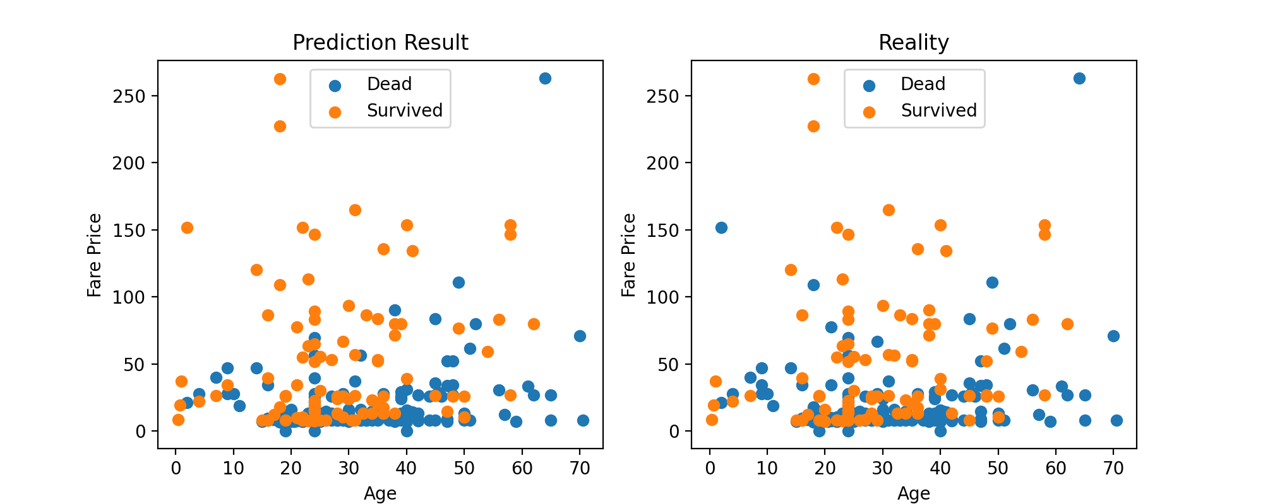
Result of Titanic Dataset
Set the learning rate to be 1.
n _estimator to be 140.
Fit the train set and predict on the test set.
Pretty decent result:
Accuracy: 0.858

Slide 10
Conclusion
Pros: Adaboost classifier is very useful when processing data that need to do the multi-classifier, and need to fill the lost data. It can make the prediction more accurate by weighting the result with different alpha.
Cons:
1: Hard to do parallel computation (multi-core computation).
2: It is very sensitive to the noise data (decreasing learning rate or decreasing n_estimator can help prevent overfitting).
Notes:
What did you learn
Any improvements

